Slide 1
Optical Bistability in a five-level cascade EIT medium: an analytical approach
Speaker: Nguyen Huy Bang
Vinh University, 182 Le Duan street, Vinh City, Vietnam
Vinh, 20 March/2016

Slide 2
Outline
1. Introduction
2. Five-level cascade EIT system
3. EIT enhanced Kerr nonlinearity
4. Optical Bistability in a five-level cascade EIT medium
5. Conclusions
Vinh, 20 March/2016

Slide 3
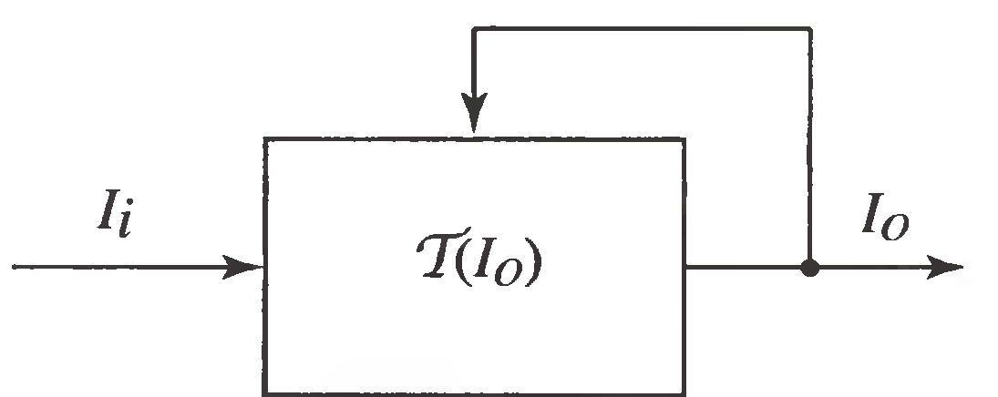
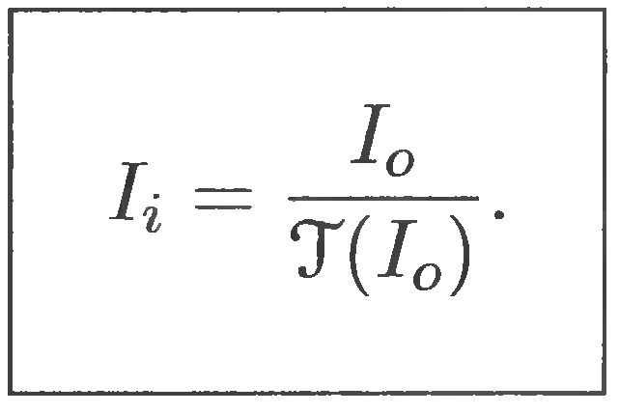
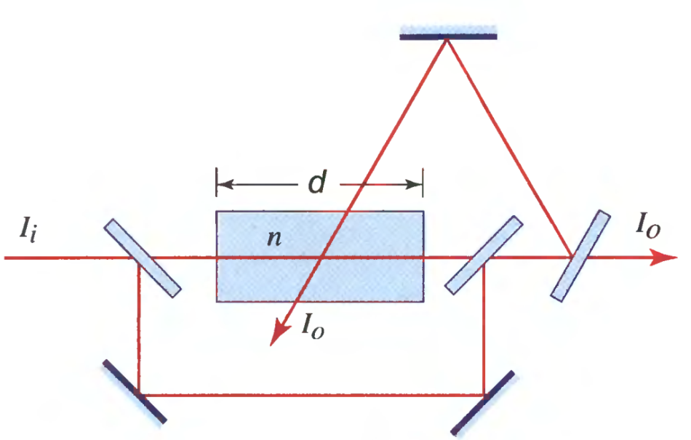
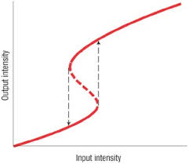
1. Introduction
What is optical bistability (OB)? Why we need analytical ?
Two requirements:
Nonlinearity n (Kerr type)
Optical feedback

Slide 4
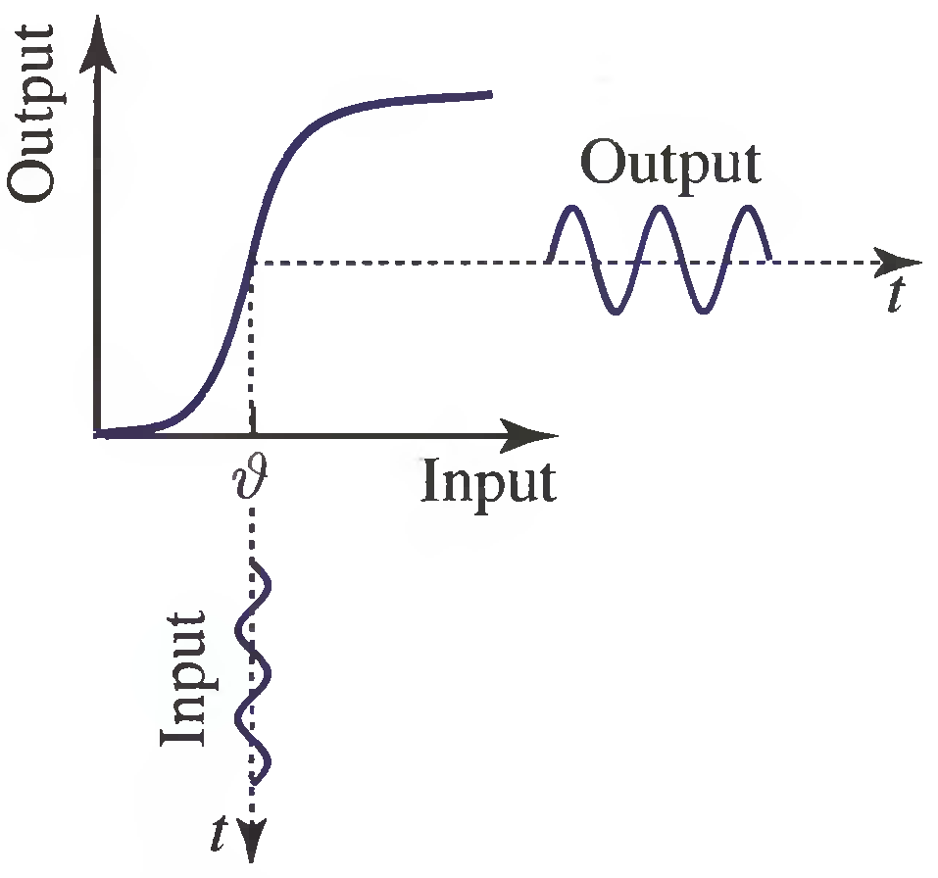
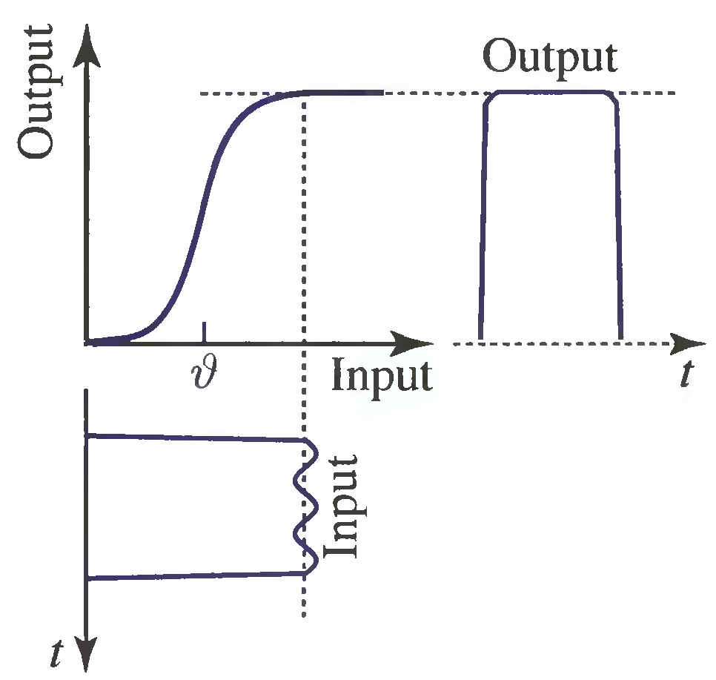
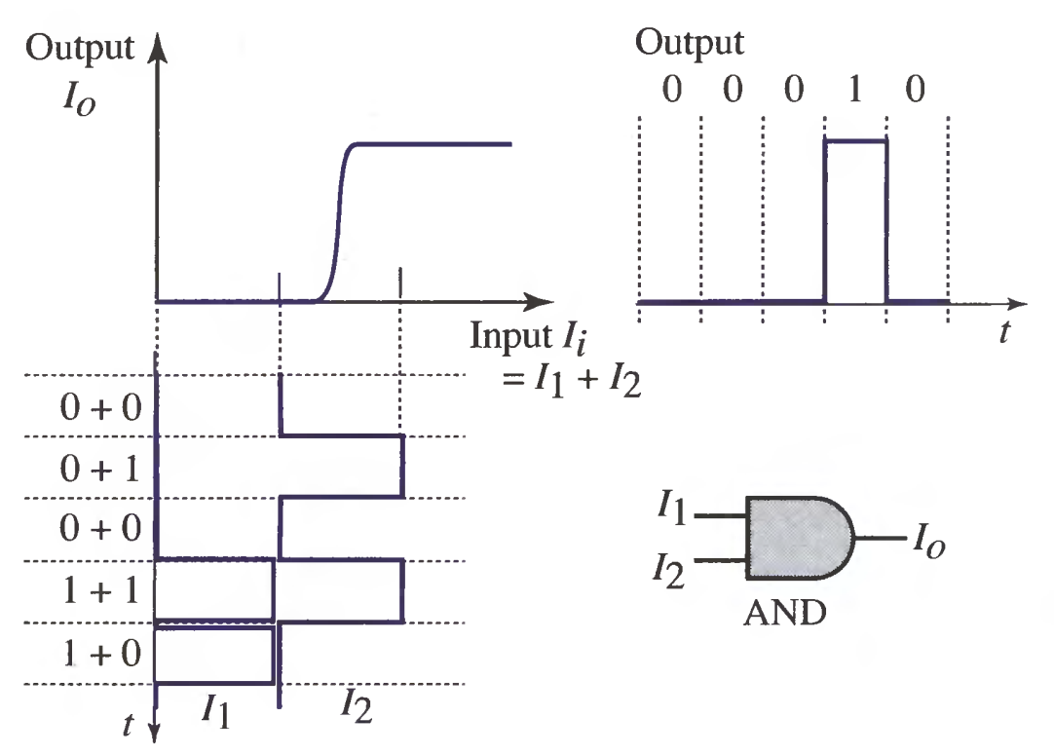
1. Introduction
Some applications of OB:
Amplifier
Pulse shaper
Logic gate AND

Slide 5
1. Introduction
Key for modern OB devices: nonlinearity as large as possible!
Two mechanisms to enhance the nonlinearity:
Fabricate new Kerr materials: n₂ ≈ 10⁻¹⁰ cm²/W
Using atomic resonances: n₂ ≈ 10⁻⁵ cm²/W
Face two problems:
Resonance absorption.
Thermal effect.
How ?

Slide 6
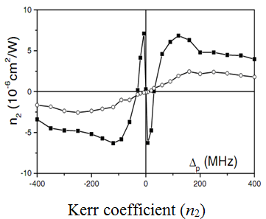
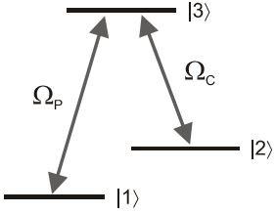
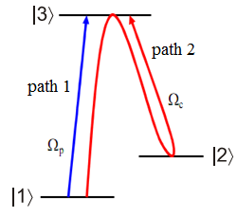
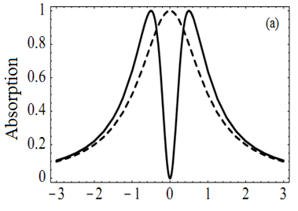
1. Introduction
Electromagnetically induced transparency (EIT):
Three-level system
Quantum interference paths.
Absorption spectrum
[2] H. Wang, D. Goorskey, and M. Xiao, “Enhanced Kerr nonlinearity via atomic coherence in a three-level atomic system”, Phys.Rev.Lett., 87 (2001) 073601

Slide 7
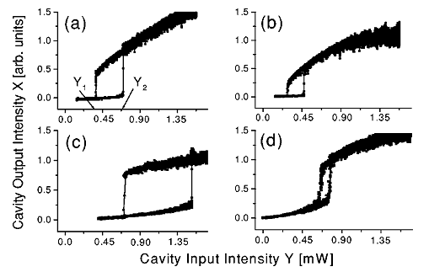
1. Introduction
Optical bistability in a three –level atomic systems:
Absorption spectrum
Disadvantage of the three-level: single window (narrow spectral region)!

Slide 8
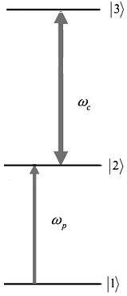
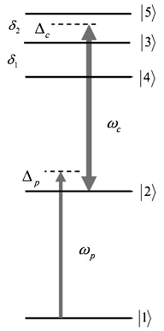
2. Five-level cascade EIT system
Three-level cascade system
Five-level cascade system
Requirement: + Closely-spacing levels: (hyperfine states);
+ Intense coupling laser
J. Wang et al, Phys.Lett.A 328(2004) 437

Slide 9
2. Five-level cascade EIT system
The mater equation:
25 equations for ρ_{ik} (i, k = 1..5)
Relationship between ρ and χ:
Perturbation technique:

Slide 10
2. Five-level cascade EIT system
a_{ik} (relative transition strengths )
Optik 125(2014) 3666

Slide 11
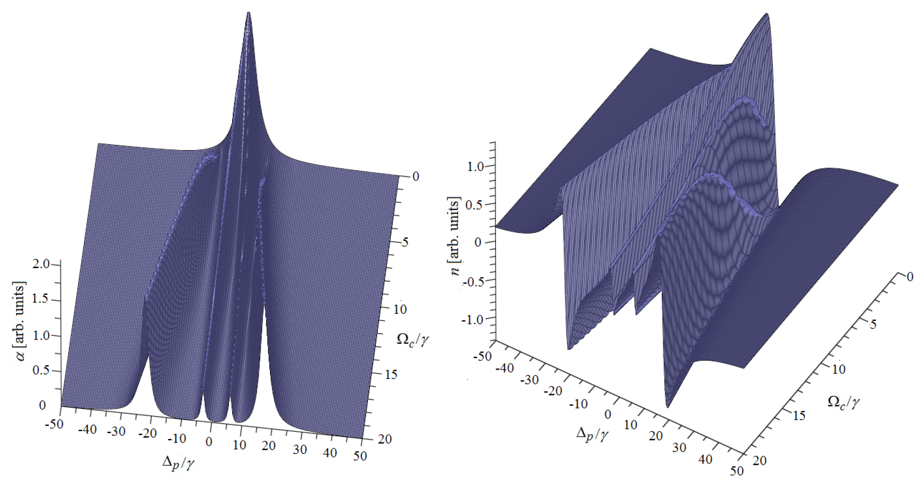
2. Five-level cascade EIT system
Optik 125(2014) 3666-3669

Slide 12
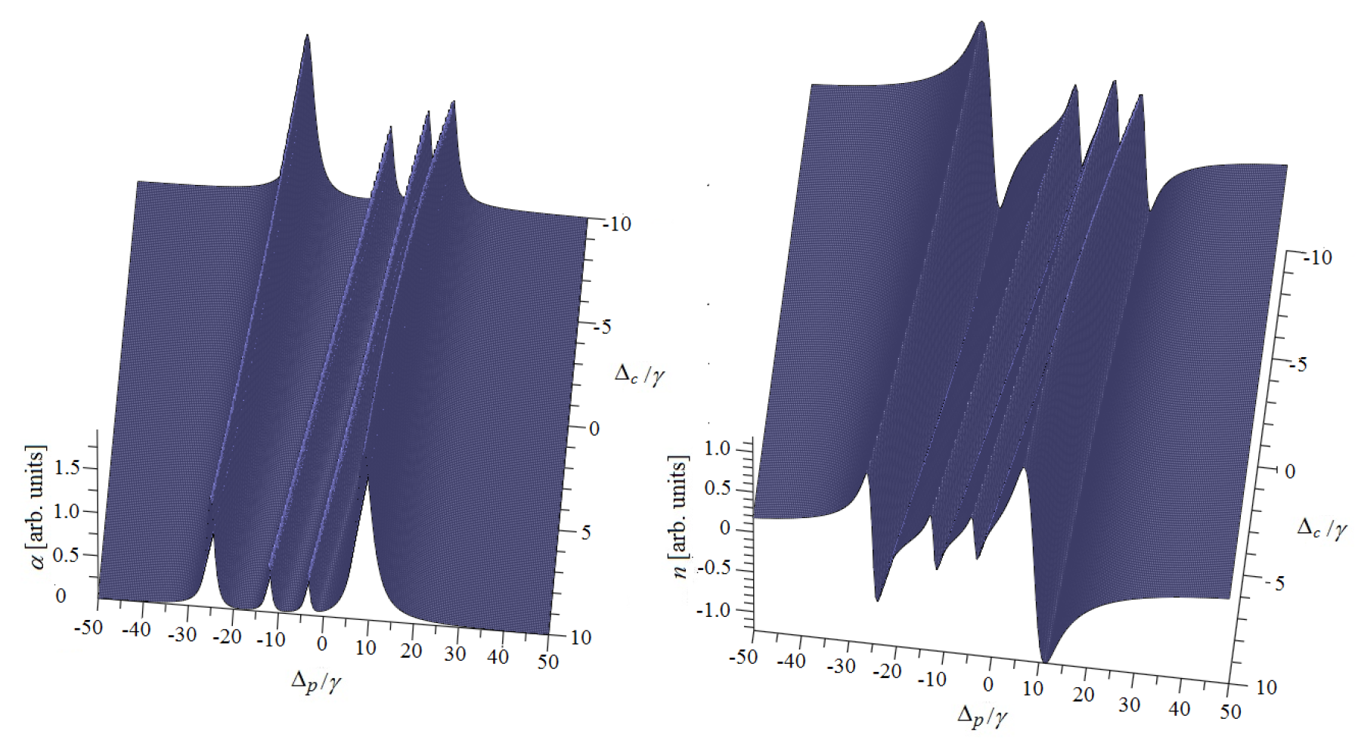
2. Five-level cascade EIT system
Optik 125(2014) 3666-3669

Slide 13
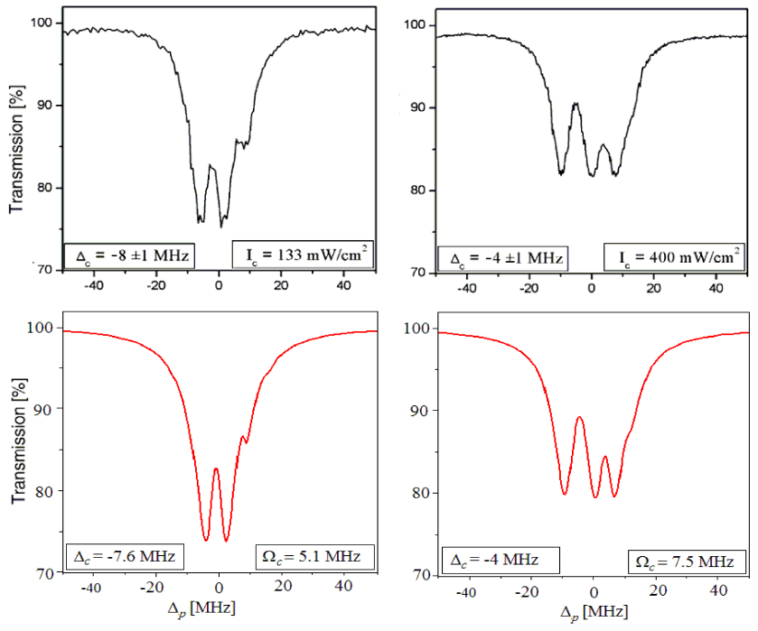
2. Five-level cascade EIT system
Optik 125(2014) 3666; J. Noncryst. Solid. 355 (2009) 1295

Slide 14
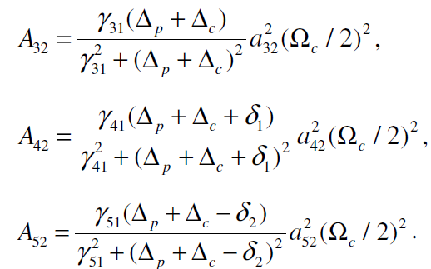
3. EIT enhanced Kerr nonlinearity
Third-order perturbation χ⁽³⁾:
Kerr coefficient
Effective coupling
parameters
J. Opt.Soc.Am. B/Vol.31.No.6 (2014) 1330

Slide 15
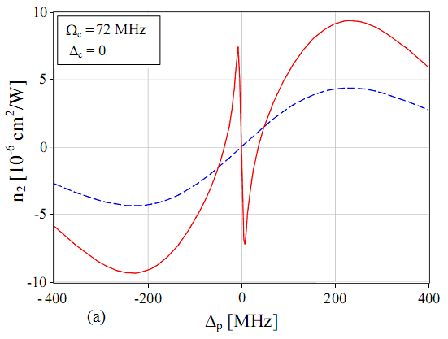
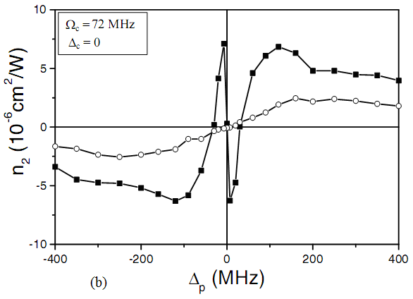
3. EIT enhanced Kerr nonlinearity
n₂ With EIT
n₂ Without EIT
D.X.Khoa et al., Physica Scripta 90 (2015) 045502; H. Wang et al., Phys.Rev.Lett. 87(2001)073601

Slide 16
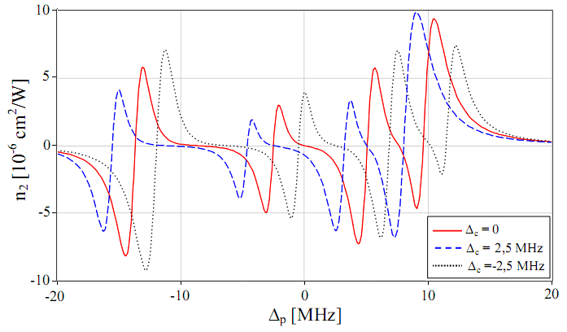
3. EIT enhanced Kerr nonlinearity
n₂ can be controlled!
Dinh Xuan Khoa et al, J. Opt.Soc.Am. B/Vol.31.No.6 (2014) 1330

Slide 17
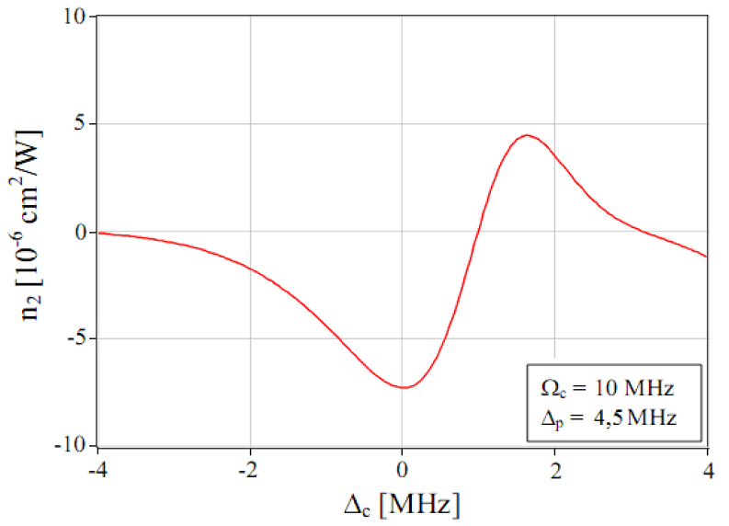
3. EIT enhanced Kerr nonlinearity
Dinh Xuan Khoa et al, J. Opt.Soc.Am. B/Vol.31.No.6 (2014) 1330

Slide 18
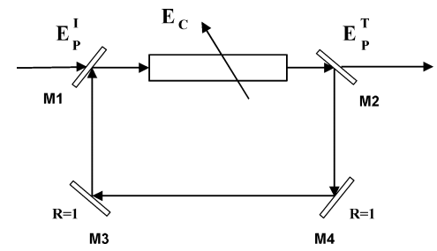
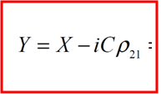
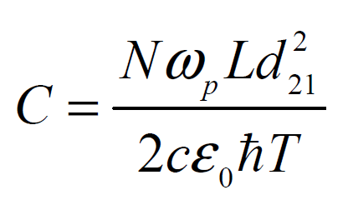
4. Optical bistability (OB) in a five-level EIT medium
n₂
18
J.Opt.Soc.Am. B (2016) – In press

Slide 19
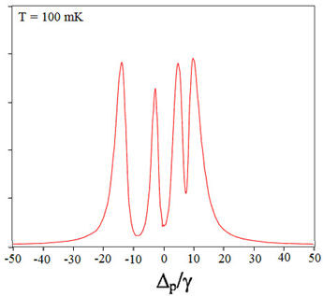
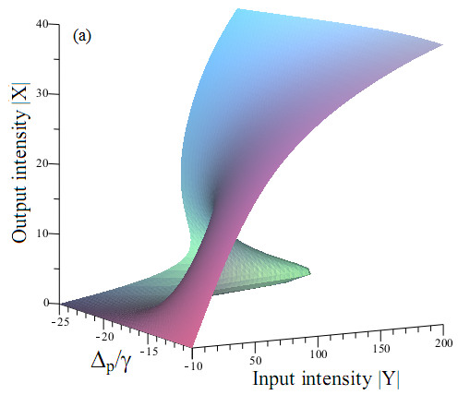
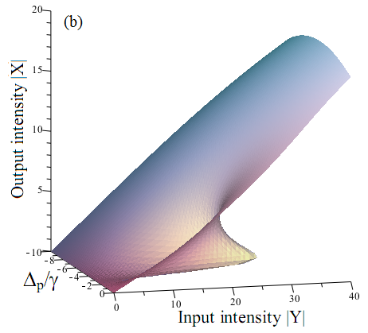
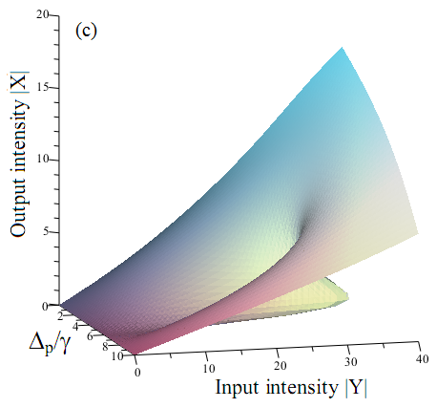
4. Optical bistability (OB) in a five-level EIT medium
absorption
19
J.Opt.Soc.Am. B (2016) – In press

Slide 20
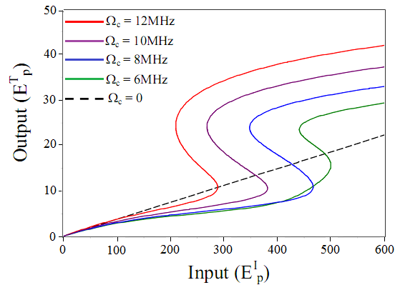
4. Optical bistability (OB) in a five-level EIT medium
Influence of the coupling intensity:
Δ_{c} = 0, Δ_{p} = 6 MHz , C = 1000
20
20
20
J.Opt.Soc.Am. B (2016) – In press

Slide 21
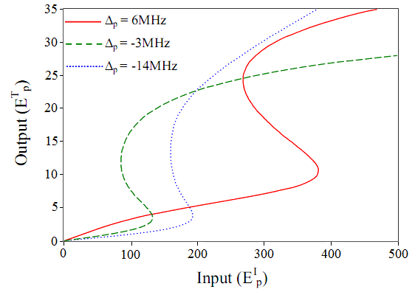
4. Optical bistability (OB) in a five-level EIT medium
Influence of the probe detuning:
Δ_{c} = 0, Ω_{c} = 10 MHz
21
J.Opt.Soc.Am. B (2016) – In press

Slide 22
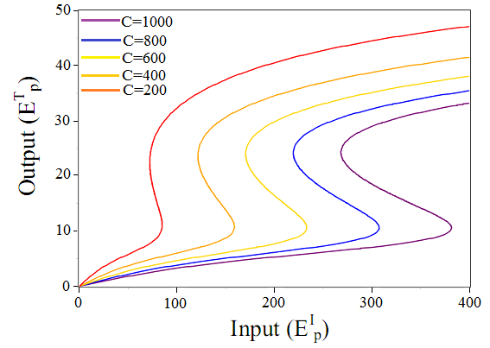
4. Optical bistability (OB) in a five-level EIT medium
Influence of the cooperation parameter:
Δ_{c} = 0, Δ_{c} = 6MHz, Ω_{c} = 10 MHz
22
J.Opt.Soc.Am. B (2016) – In press

Slide 23
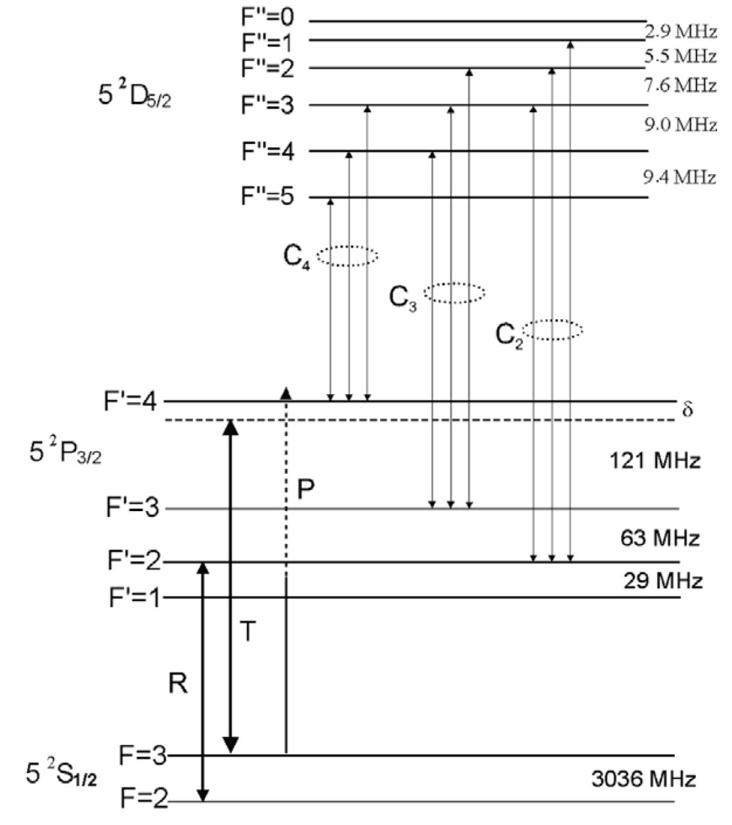
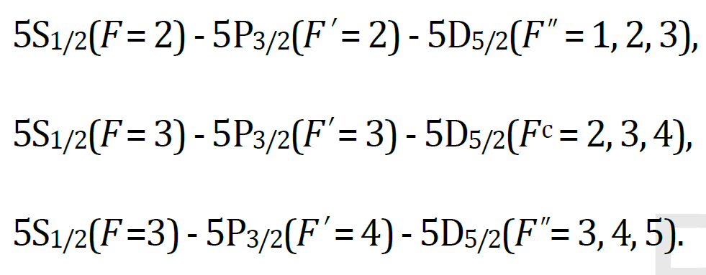
4. Optical bistability (OB) in a five-level EIT medium
Possible realization in experiments:
⁸⁵Rb atoms
23
J.Opt.Soc.Am. B (2016) – In press

Slide 24
5. Conclusions
An OB model has been proposed:
Working at three atomic resonances in the present of EIT
Analytical interpretations input-output;
High Kerr nonlinearity (10⁻⁵ cm²/W): low threshold;
OB behaviors can be controlled with the coupling light
Future works:
Role of absorptive and dispersive on OB;
Role of Kerr nonlinearity on OB;
Realize experimentally;
Influences of Doppler broadening;
All-optical switching;

Slide 25
Thank you!
Vinh, 20 March/2016

